Slide 1

RIGHT ENERGY PARTNERSHIP WITH INDIGENOUS PEOPLES
Joan Carling
Co-convenor, Indigenous Peoples Major Group for the Sustainable Development Goals (IPMG)

Slide 2
Context
Goal 7 of the SDGs: Clean and affordable Energy for all
Climate Change: Just transition from Fossil fuel
to renewable energy
CHALLENGES for Indigenous Peoples:
  Millions lack of access to energy inspite od hosting
  energy projects
  Massive violation of the rights of indigenous people in energy development
  land grabbing, displacements, destruction of livelihoods, food insecurity and increased vulnerability to violence of indigenous women, conflicts, detention, killings
  Lack of inclusion of Indigenous Peoples in existing Energy Partnerships

Slide 3
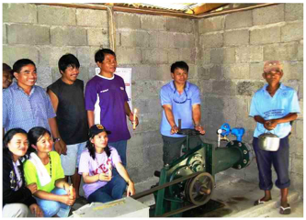
OPPORTUNITIES:
  The pledge of ”leaving no one behind and reaching those furthest behind first ”
  SDGs seek to realize human rights for all
  Partnerships to achieve the SDGs
  Constributes directly to achieving other SDGs: ending poverty; ending hunger, empowerment of women and girls: Economic growth and decent work; reduce inequality : Goal 15- conservation of forest and biodiversity and climate change
  Paris Agreement /climate change solutions
  Indigenous people’s initiatives for renewable energy

Slide 4
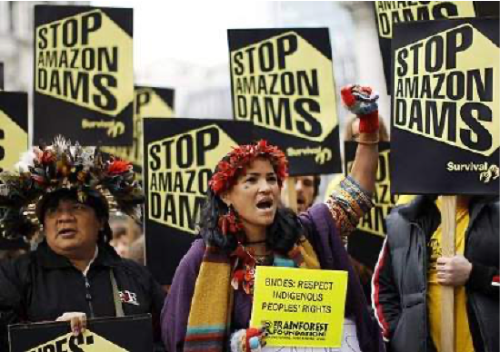
The Right Energy Partnership with Indigenous Peoples-REP
OPEN PLATFORM FOR STAKEHOLDERS AND DEVELOPMENT
GOALS and GUIDED BY AN AGREED SET OF PRINCIPLES
Ensure that renewable energy projects are fully
aligned with the respect and protection of human rights;
Facilitate access to renewable energy of least 50 million indigenous peoples access by 2030 consistent with their development aspirations.

Slide 5
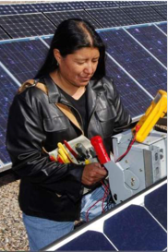


PARTNERSHIP PRINCIPLES
PARTNERSHIP PRINCIPLES
Respect and uphold human rights core core
Equitable benefit sharing and the consistent
promotion of equity
Full inclusion and empowerment of
indigenous women
Respect and promotion of self-determined
sustainable development
Full participation and empowerment of indigenous communities
Uphold indigenous leadership
Transparency, accountability and mutual respect

Slide 6
Key Activities:
Mobilize financial and technical support for community based renewable energy for indigenous communities
Support community-level pilot projects to build on and replicate best practice in indigenous-led sustainable energy solutions.
Launch advocacy campaigns for a rights-based approach to renewable energy development by states and the private sector:
Build and strengthen partnerships with different development actors including UN agencies in advancing community –based solutions to renewable energy development; empowerment of indigenous women

Slide 7
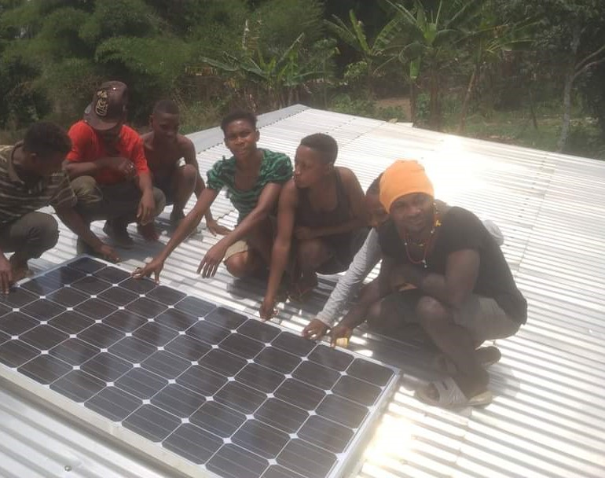
PartnERSHIP with UNDP-SGP
Funding support to community –based renewable energy projects of indigenous peoples in least developed countries
Cameroon, DRC, Honduras, Nepal etc
  Solar power generation for communities
  Support to COVID response
  Training of youth for technical maintenance
  Alternative energy use: bio-gas
  Empowerment of indigenous women

