Slide 1
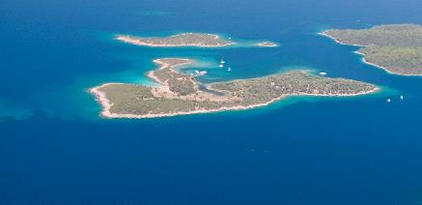
SGP's overall Island’s Resilience Approach
and Programming in Pacific and other SIDS
Yoko Watanabe

Slide 2
Divider slides four color options to choose from
Subtitle will go here

Slide 3
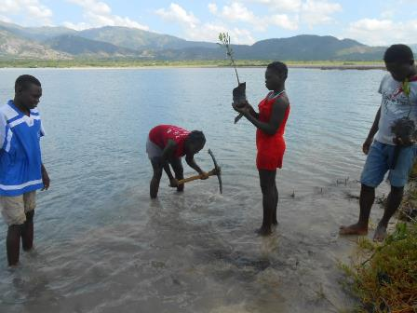
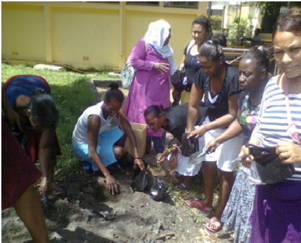
SGP SIDS Approach and Strategic Objectives
SGP approach: develop and demonstrate effective and innovative community-based actions and practices supporting implementation of the Community level climate impacts reducing measures
SGP’s niche: complements national, regional and global levels, ensuring the comprehensive coverage of islands resilience interventions.

Slide 4
SGP’s Strategies for Islands Resilience
OUTCOME 1
LOCAL LEVEL
OUTCOME 2:
NATIONAL LEVEL
OUTCOME 3:
GLOBAL LEVEL
Enhanced adaptive capacity allows communities to reduce their vulnerability to adverse impacts of future climate change driven risks
    Community-level capacity building and awareness-raising on climate change
    Portfolio of adaptation projects per country, in
    42 countries
National policies and programmes promote replication of best practices derived from
CBA projects
    Dissemination/promotion of lessons learned at the national level
    Involvement of policymakers in CBA projects and processes
Cooperation among member countries promotes innovation
in adaptation to climate change including variability
    Transboundary learning, based
    on best practices identified by communities
    Lessons learned
    on CBA transmitted
    to global stakeholders, including GEF-secretariat

Slide 5
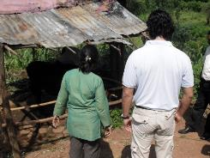
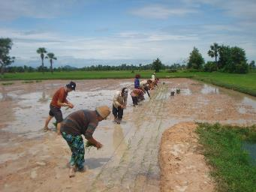
Approach in the Pacific Region
SGP Regular Approach Sub regional modality
Samoa Sub region (Samoa, Niue, Tokelau,
Cook Island)
Fiji Sub region (Fiji, Nauru, Tonga, Tuvalu, Kiribati)
Global Grant Approach
Works with Global INGO’s
  GLIPSA
Works with regional organizations
  Foundation for Youth Development
  (Nauru, Tonga and Tuvalu)
  Te Ispukarea Society
  (Niue, Tokelau & Cook Island)

Slide 6
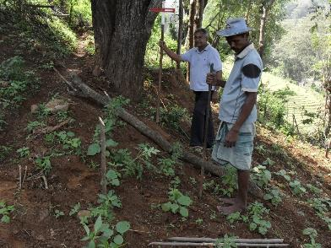
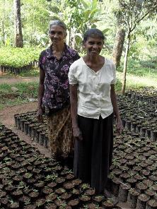
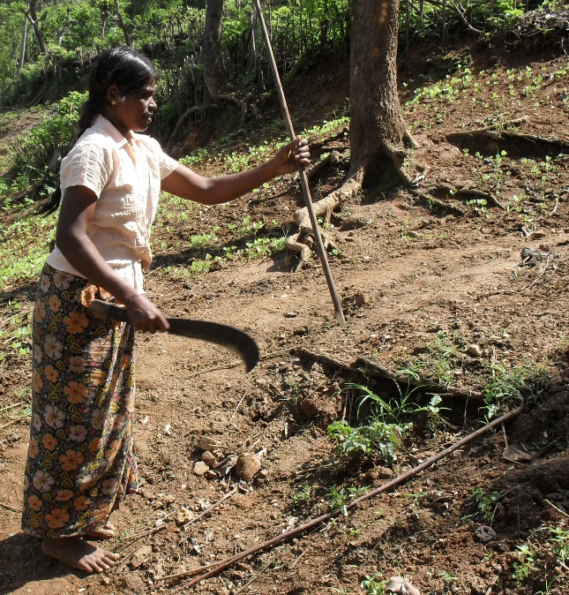
Rationale for Different
Approach in the Pacific's SIDS
No SGP presence in some countries
Follow the other UN Modality of Joint presence offices-Draws on this support
Low population and poor connectivity
Low capacity and insufficient number of NGO’s and CBO’s
Low and slow absorption of funding resources

Slide 7
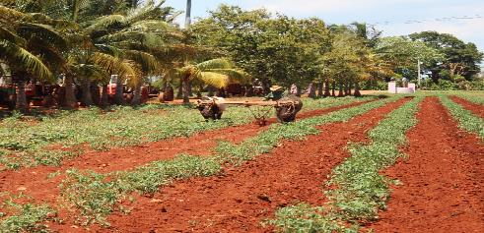
Portfolio in Fiji, Palau and Marshals Islands
BASIC STATS | TOTAL AMOUNTS | AVERAGE AMOUNTS
Number of Projects | 186
Total Amount in Grants | 6 670 802 USD | 35 865 USD
Total Amount of Cash Co-financing | 974 356 USD | 5 238 USD
Total Amount of Kind Co-financing | 3 558 438 USD | 19 131 USD
Total Amount of Co-financing | 4 532 795 USD | 24 370 USD

Slide 8
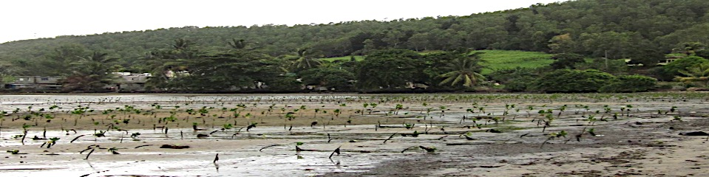
SIDS CBA
Project Objectives
To improve the adaptive capacity of communities, thereby
reduce vulnerability to the adverse effects of climate change risks,
To provide countries with concrete ground-level experience
with local climate change adaptation, and
To provide clear policy lessons, make efforts to mainstream
into national processes and up scale practices across scale.

